Slide 1
QUALITY ACTION CONCEPT AND METHODS
Improving Quality in HIV Prevention (QHP) EU Joint Action Project 2013-16
﻿Name Speaker

Slide 2
﻿Aim
TITLE
To improve the quality of the response to HIV and AIDS in Europe
by
increasing the effectiveness of HIV prevention using practical Quality Assurance (QA) and Quality Improvement (QI) tools
Notes:
Quality Action focuses on the quality of HIV prevention programs and projects to maximise their effectiveness.
Quality assurance and improvement at the strategic level aim to ensure that decisions about what to do and which methods to use are based on the best available scientific evidence, implementation knowledge and expert opinion available.
Quality Assurance (QA) and Quality Improvement (QI) at the project level aim to ensure that the chosen activities are planned, carried out, monitored and evaluated as well as possible to maximise their potential affect.
The overall effectiveness of HIV prevention is influenced by many factors. Choosing the approaches, interventions and methods most appropriate to a given situation and carrying them out at a high level of quality are two of them.

Slide 3
What do we mean by QUALITY?
TITLE
Quality means achieving desirable health outcomes in a manner consistent with current professional knowledge and standards.
Notes:
Viveca Urwitz said “ It’s not enough to do the right things, we need to do the right things right.”
But QI is not about finding fault with everything.
Mostly it is about taking the time to recognise how well we are doing already, and how.
Only when we are aware of how we are doing well can we use this knowledge to do even better.

Slide 4
Quality in HIV prevention
TITLE
Preventing new HIV infections and disease in a manner consistent with the best available evidence, theory and experience.
Notes:
Evidence for making sound decisions in HIV prevention is available from a range of sources.
Traditional scientific evidence using trials is not always available or conclusive, especially for structural, social and behavioural interventions.
A lack of high-order evidence does not mean an approach or method is ineffective and should not stifle innovation.
Insights gained by comparing the effects of historically different approaches in different places, case studies and the experience of practitioners complement our knowledge.
The consensus of stakeholders on plausible explanations for success or failure and on plausible rationales for innovative approaches are very important.
Quality Improvement can help articulate and document these types of evidence.

Slide 5
THIS IS A TITLE #1
Notes:
We can think of quality as a slope. Our goal is to travel along it in an upward direction.

Slide 6
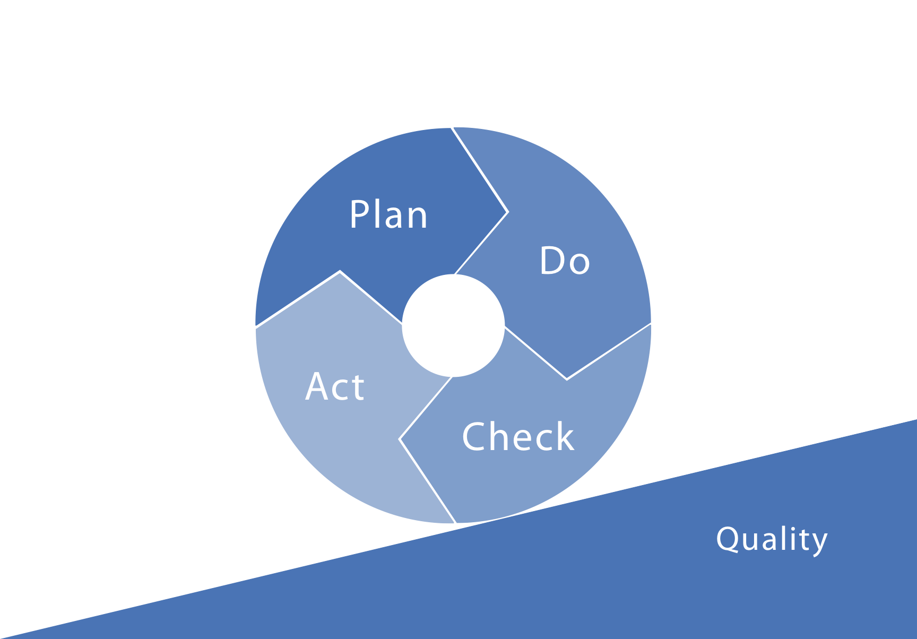
THIS IS A TITLE #1
Notes:
An HIV prevention activity, project or program can be thought of as a continuous cycle of: planning what to do, doing it, then checking it, then acting on the results.
This type of cycle is familiar to many as the “public health action cycle” or from project management, action research and similar models.
The important characteristic of programs and projects is that they happen in cycles, both at the micro- and at the macro-level.
Quality improvement can be applied to any phase of the cycle. It is most effective if it is applied to all.

Slide 7
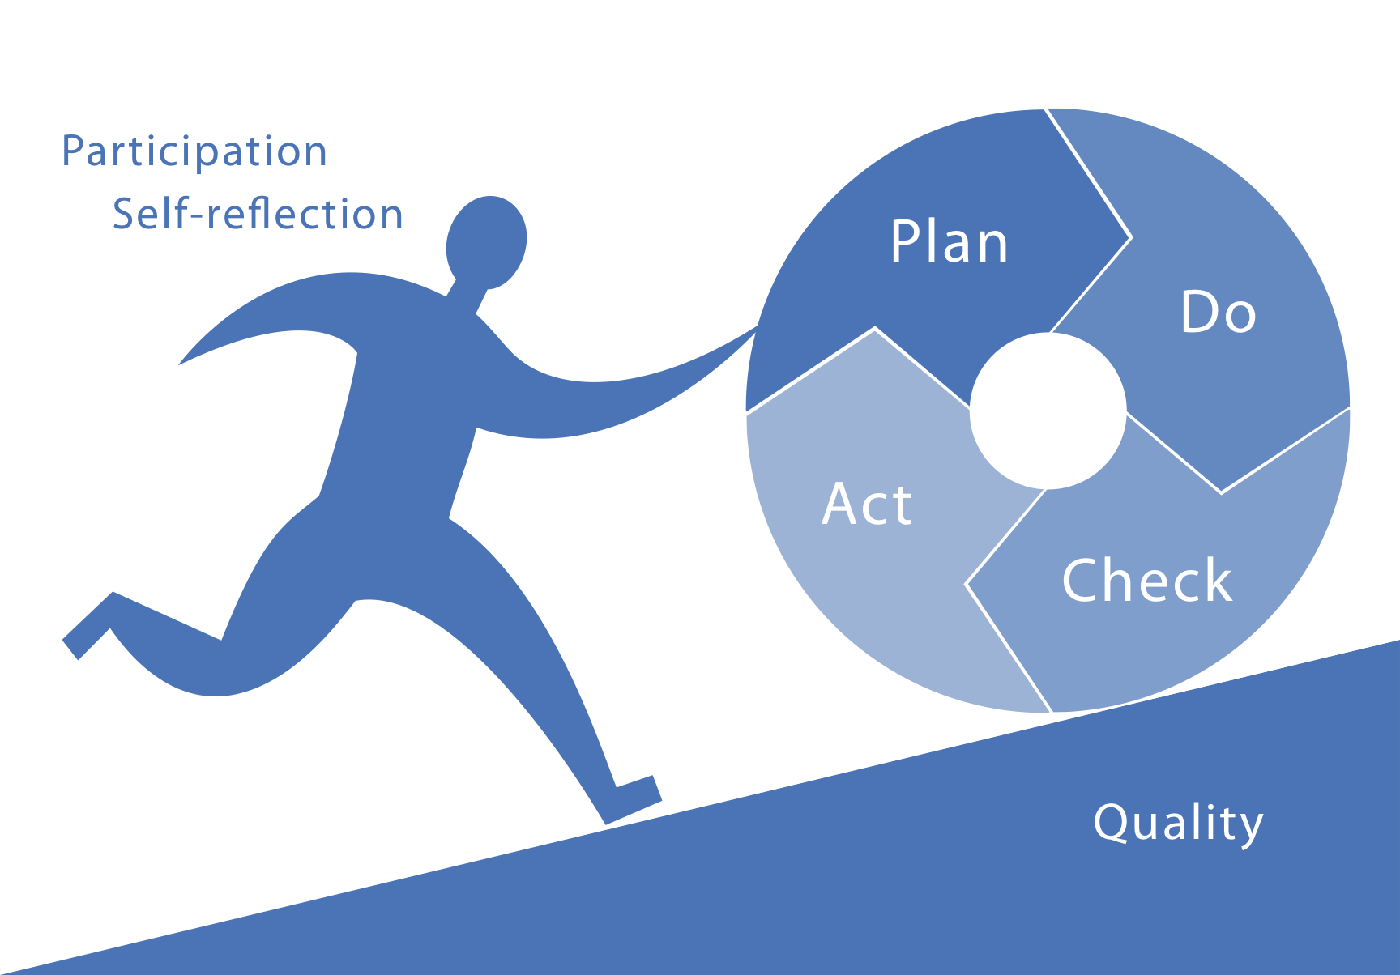
THIS IS A TITLE #1
Notes:
Our purpose as prevention practitioners is to push the quality of the project up.
Participation and self-reflection are fuelling this effort.
They make it possible to recognise opportunities for quality improvement and to act on them by making changes and monitoring the results.
Participation is important because no single point of view can give an accurate picture of the context in which a HIV prevention activity operates.
The participation of the target group is especially significant. If the project does not respond to the needs of its clients (from the clients’ point of view), it is unlikely to be effective.
Self-reflection means stepping back to critically examine how well our efforts actually worked. It takes courage and a supportive environment to take this position. It is important to remember that we did and do our best under the circumstances.
Rigorous self-reflection is a prerequisite for improving quality because the assumptions we protect most fiercely are often the most rewarding to question.

Slide 8
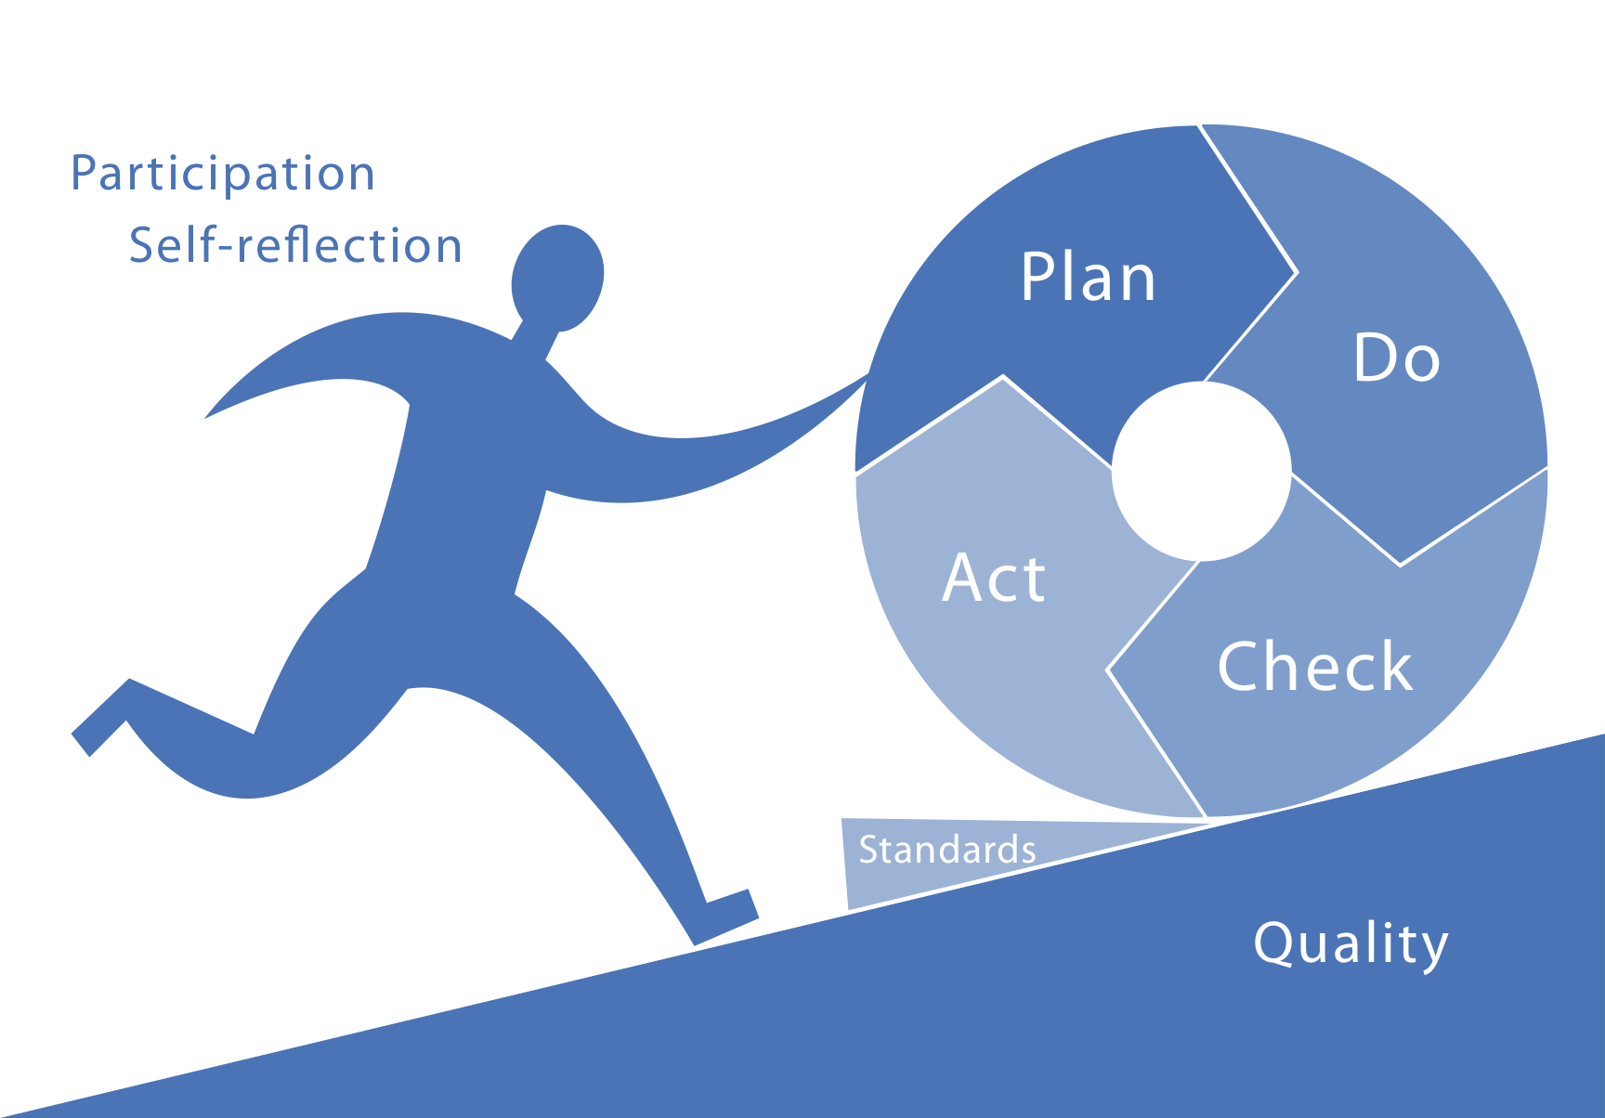
THIS IS A TITLE #1
Notes:
Standards document improvements and learning gained in the process.
In the wider quality field, standards are used where activities can be described in detail and reproduced accurately over and over. The originate in manufacturing and exist to some extent in clinical medicine (quality control, quality assurance).
HIV prevention is very context-dependent, and the rigid transfer of standardised methods from one context to the next does not work in the same way.
However, standards that emerge documented during local quality improvement practice ensure that the project does not roll back down the quality slope. Especially considering staff changes and other disruptions.
How widely applicable the emerging standards are depends on the context:
they may be specific to an individual project (e.g. a prevention project for young Caribbean migrants in a particular suburb of London must be negotiated with a certain church group), or
they may be useful for a particular method across a range of contexts (e.g. all NSPs should include a needs assessment among the target group to find out about local injecting practices in order to supply the most popular sterile injecting equipment), or
for a variety of methods within a single context (e.g. all MSM prevention projects should include the promotion of STI testing as well as condom use and HIV testing.

Slide 9
Key Principle: Participation
TITLE
Stakeholder involvement
Communication, consultation and facilitation
Team and group work
Empowerment
Notes:
Increasing the number of perspectives means involving stakeholders meaningfully.
Those who have an interest in the program or project, especially the audience or target group, are asked to contribute their point of view.
Many Quality Improvement tools ask questions that different stakeholders will answer differently, depending on their particular perspective.
Eliciting these answers requires skills in communication, consultation and facilitation.
Engaging in Quality Improvement creates time and space for communication and exchange within teams.
One of the outcomes of using quality improvement tools in a participatory fashion is increased team interaction and the opportunity for productive group work.
Building the participation of disadvantaged target groups in a meaningful and committed way contributes to empowerment.

Slide 10
Key Principle: Self-Reflection
TITLE
Voluntariness
Supportive environment
Structured process
Satisfaction
Notes:
Many work places have hierarchical cultures. Control and judgement can lead workers to fear quality assurance and quality improvement processes.
Self-reflection is unlikely to lead to an honest and objective assessment of HIV prevention practice if it is forced or performed under pressure.
A supportive environment must be free from the threat of humiliation. Mistakes are more usefully seen as opportunities for learning.
We already reflect on our work in our own minds and from time to time even in conversations with colleagues. However, these reflections are rarely structured, rarely look at all aspects of a program or project, rarely include all relevant stakeholders, are rarely documented and rarely lead to systematic changes.
Quality Assurance and Quality Improvement tools offer a structured approach. They guide us through these steps and help to reflect and make measurable improvements.
QA/QI is a process that shows what we are doing well already. It offers clear steps to making improvements. Seeing successes, overcoming discouragement in the face of failures and being able to make tangible improvements boost the morale and satisfaction of workers and other stakeholders.

Slide 11
Quality Assurance or Improvement?
TITLE
Quality Assurance (QA) monitors the quality of services and activities against standards, including review, problem identification and corrective action.
Quality Improvement (QI) identifies, implements and evaluates strategies to increase the capacity to fulfil and exceed quality standards.
Notes:
Quality is an important aspect of any project.
Quality Assurance is particularly suitable where standardised services are offered, such as medical and clinical procedures (e.g. testing and counselling).
However, most HIV prevention interventions are more complex. They also include information, education, behavioural interventions and community development.
Quality Improvement methods are more flexible than Quality Assurance. They can be applied to complex interventions that are tailored to particular contexts and settings.

Slide 12
Documentation
Moni
toring
I
N
T
E
R
V
E
N
T
I
O
N
activities
TITLE
Evaluation
Planning
Analysis
service provision
Consultation
Needs Assessment
Review
Implementation
Notes:
Projects and programs often feel burdened with processes aimed at proving and improving effectiveness.
Is promoting QA/ QI nothing more than adding another bureaucratic layer?

Slide 13
Programs and projects of high quality
TITLE
Analysis and needs assessment
Consultation and planning
Implementation and service provision
Monitoring and evaluation
Documentation and reporting
Review
All of high quality
Notes:
No. Ideally, QA/QI is not separate, it influences all these components.
QA/QI have the potential to get the best value out of the processes that are already part of good project/program management.
QA/QI does not replace existing decision-making processes. It does not replace needs assessment, planning, implementation, monitoring, evaluation or documentation.
It offers a conscious, deliberate, hands-on way of making sure that these project management activities are of the highest achievable quality .

Slide 14
Methods
TITLE
Evidence based tools, expert-led adaptation, pilot application, consultation and review
Train-the-trainer, adult education, e-learning, practice-based learning,
Development of quality factors, consultation
Policy review, advocacy and negotiation
Process, output and outcome evaluation
Notes:
Quality Action uses established methods to reach its goal.
Its QA/QI Tools are based on evidence from a range of health, social science, development and management disciplines. They have been adapted to the complexity of factors that influence the effectiveness of HIV prevention programs and projects. Some have already been tested in practice.
Pilot application of the tools as part of Quality Action will include consulting participants and using their feedback to revise the tools.
The capacity-building component uses the ‘train-the-trainer’ method to build a skills base and a sustainable network of trainers and facilitators.
the project’s Charter for Quality in HIV Prevention documents quality factors. It will be based on literature review, data collected during the practical application of the tools and consulting with experts.
Review of existing policy and strategic documents, advocating for the inclusion of quality and negotiating with policy makers will result in policy recommendations.
W evaluate Quality Action using complementary methodologies of process, output and outcome evaluation. We also apply a QI tool to the Joint Action itself.

Slide 15
Thank you for your attention!
TITLE
For information:
matthias.wentzlaff-eggebert@bzga.de
To apply tools:
carolin.vierneisel@dah.aidshilfe.de
Notes:
Matthias Wentzlaff-Eggebert is the contact person at BZgA, the coordinating partner of Quality Action.
Carolin Vierneisel coordinates Work Package 6: Practical Application. She can assist you if you want to join the main activities of Quality Action and apply a QA/QI tool to your work as part of the project.
9 Reasons to get involved in Quality Action:
Become aware of what you are already doing well
Learn about when, how and why you are already successful (and sometimes fail)
Get new ideas on how to improve what you are doing
Increase participation and benefit from stakeholder input
Provide yourself with space and time to reflect on your work and build on your team and internal communication
Enhance your co-workers/employees’ work satisfaction
Build different types of evidence that supports your HIV prevention interventions
Simplify and enhance the planning, implementation, monitoring and evaluation of your projects and programs
Network with other European organisations in make HIV prevention more effective.

